Slide 1
Modular programming in python

Slide 2
today
We will now look at the art of reusing and sharing functions between programs in Python.

Slide 3
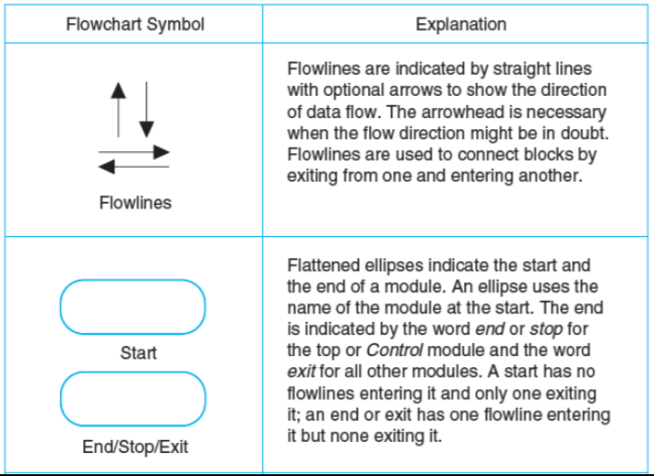
flowcharts

Slide 4
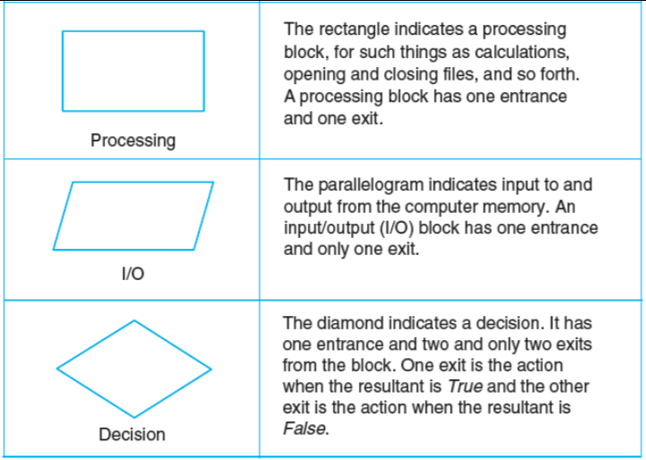

Slide 5
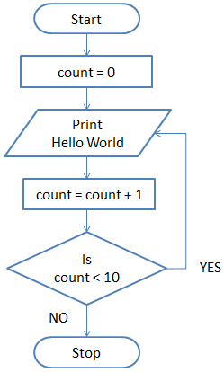

Slide 6
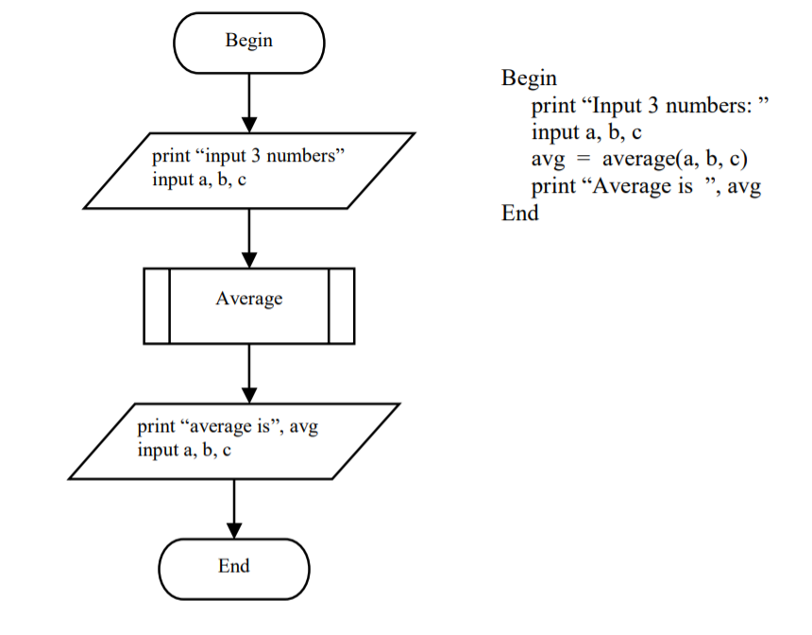
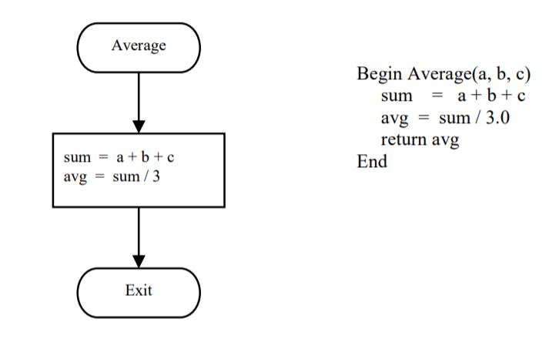

Slide 7

Functions in Python

Slide 8

Python Procedures
Note – you can make a function act like a procedure in Python by adding:
Python does this by default, if you do not return a value, Python will automatically add the statement.

Slide 9
Advantages of Procedural Programming
Modular coding
  Once a procedure has been written in one program, it can be imported and reused in other programs.
Efficiency
  Using procedures can reduce the amount of statements used in a program
  The use of procedures can also remove the need to repeat code.

Slide 10
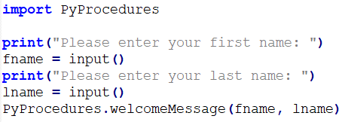
Importing Procedures - modelling
To use procedures (and functions) from other programs, use the import keyword
For this to be successful in the example, both files must be in the same folder.

Slide 11
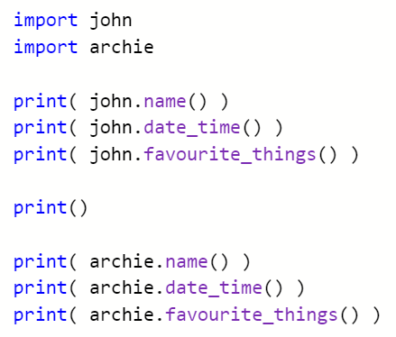
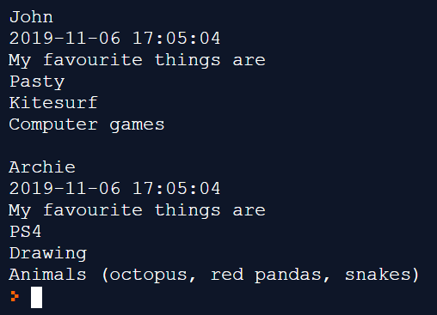
https://repl.it/@JohnGlazebrook/Python-modules

Slide 12
Research – 20 minutes
Explain the differences
from module import xyz
from module import *
import module
Example code.
Get ready for a class discussion

Slide 13
Today
Complete worksheet – take your time and make sure you understand them
Comments! Suitable variable names! Function names!

